Slide 1

Online Food-Delivery System

Slide 2
Group NO. - 6 Team Lead- Sashikumar X Group Members- Routhu Sai Kumar Ruchika Chandrashekhar Honawale Rushikesh Prabhakar Sonawane Sanjana Dhanaji Patil Shaik Uzma Tamkeen shaik yusuf Shashikumar X Shilpa Naik Shubham Sharma Shyam Mohana Sappa Singadi Sravan Kumar

Slide 3
Abstract
Developing a Fast Food Order system to promote a greater count of food lovers to splurge into the field of Restaurant. It integrates the benefits of an ordering food with the convenience of an online excitement and going with the technology, minus the commuting hazards and expenses. It will usher in the immense flexibility and sophistication in the existing manual platform structures, with the perfect blend of synchronous and asynchronous interaction. It provides a means of collaborative E ordering for the customers.

Slide 4
Scope And Purpose
SCOPE:
The project has a wide scope, as it is not intended to a particular organization. This project is going to develop generic software, which can be applied by any businesses organization. More over it provides facility to its customer. Also the software is going to provide a huge amount of summary data.
PURPOSE:
To manage the online fast food ordering. It helps to customer to book products from anywhere. Also make payment on delivery. It helps to people to book desired products at their prefer time.

Slide 5
Proposed System
The Proposed system ensures the complete freedom for users, where user at his own system can logon to this website and can book his product.
Our proposed system allows only registered users to book the product, view booking and cancel their booking as per their need.
In this Proposal the entire work is done on online.

Slide 6
Modules
Backend Modules
-Admin
-Cart
-Customer
-Product
-Purchase
Frontend Modules
-Admin
-Cart
-Customer
-Product
-Purchase

Slide 7
Software Requirement
Softwares Used:
Eclipse IDE
Visual Studio
Workbench
Operating System: Microsoft Windows/Linux

Slide 8
Technologies Used
Front-End: Angular
Server-side: Spring Boot.
Back-end: MYSQL, Hibernate.
Server: Tomcat

Slide 9
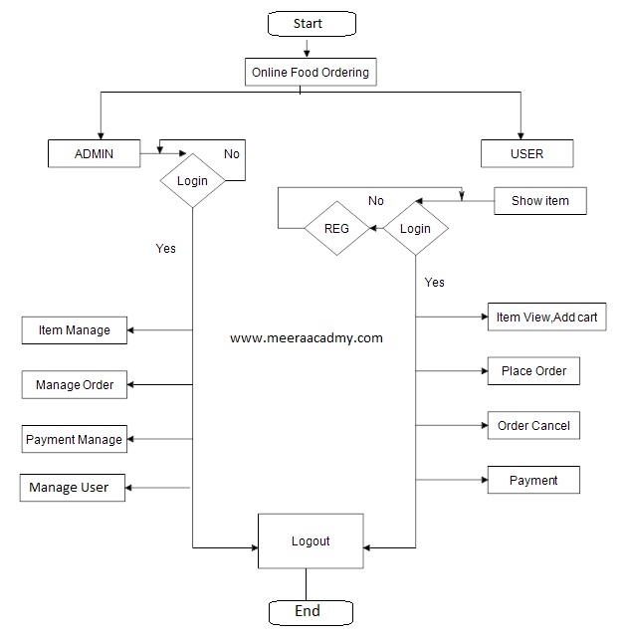
Flowchart

Slide 10
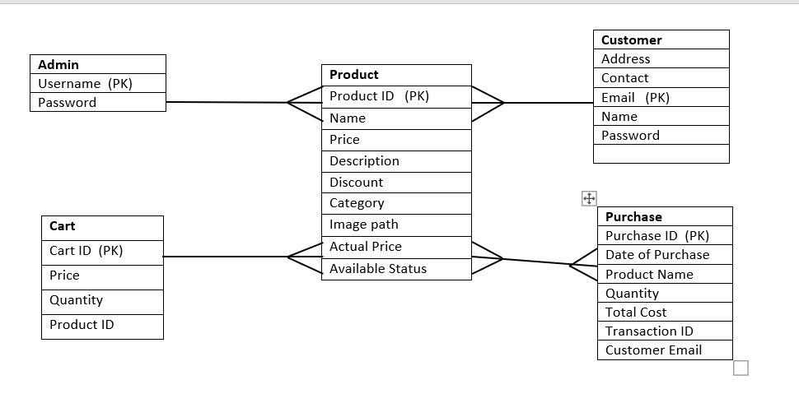
ER Diagram

Slide 11
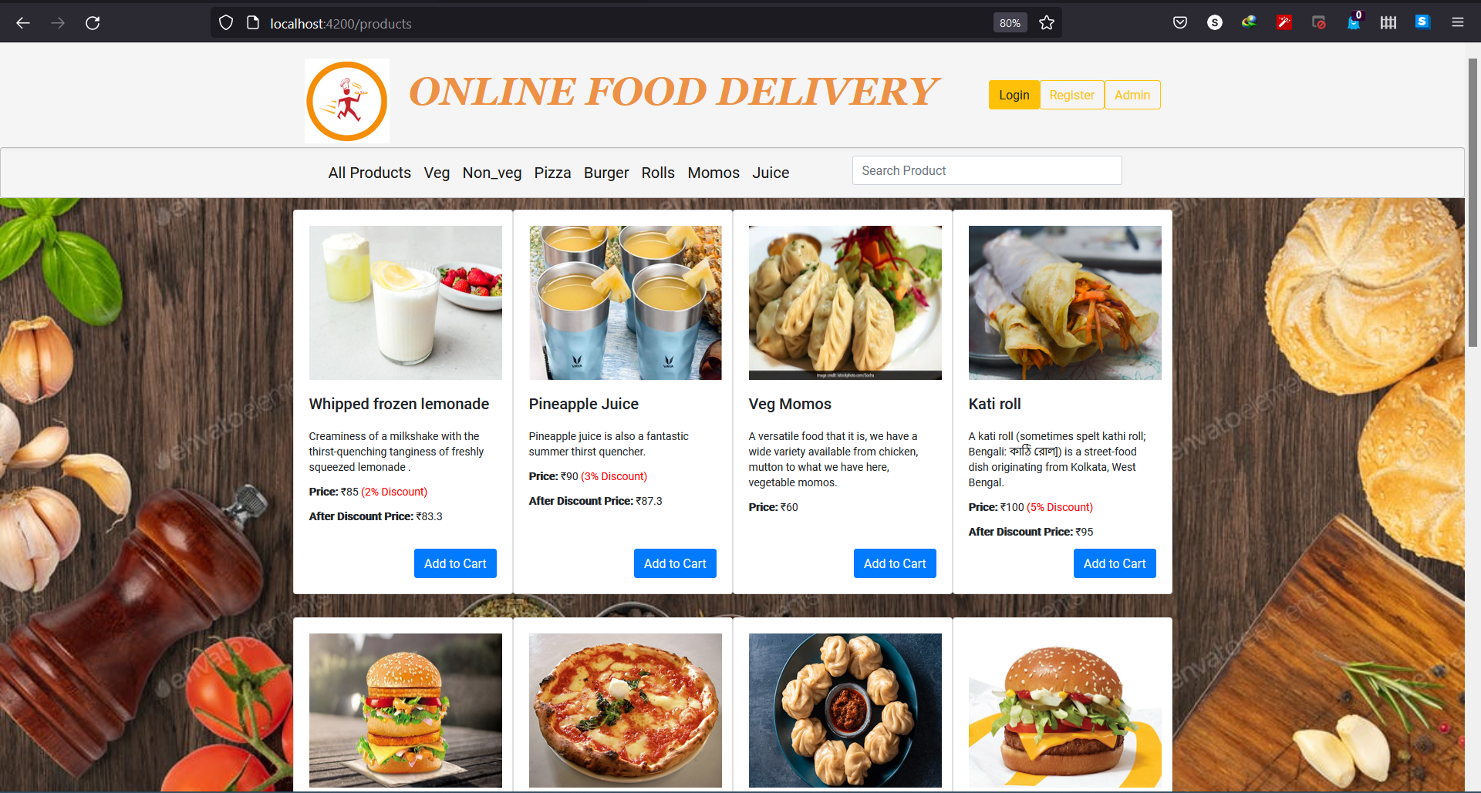
Screenshots:

Slide 12
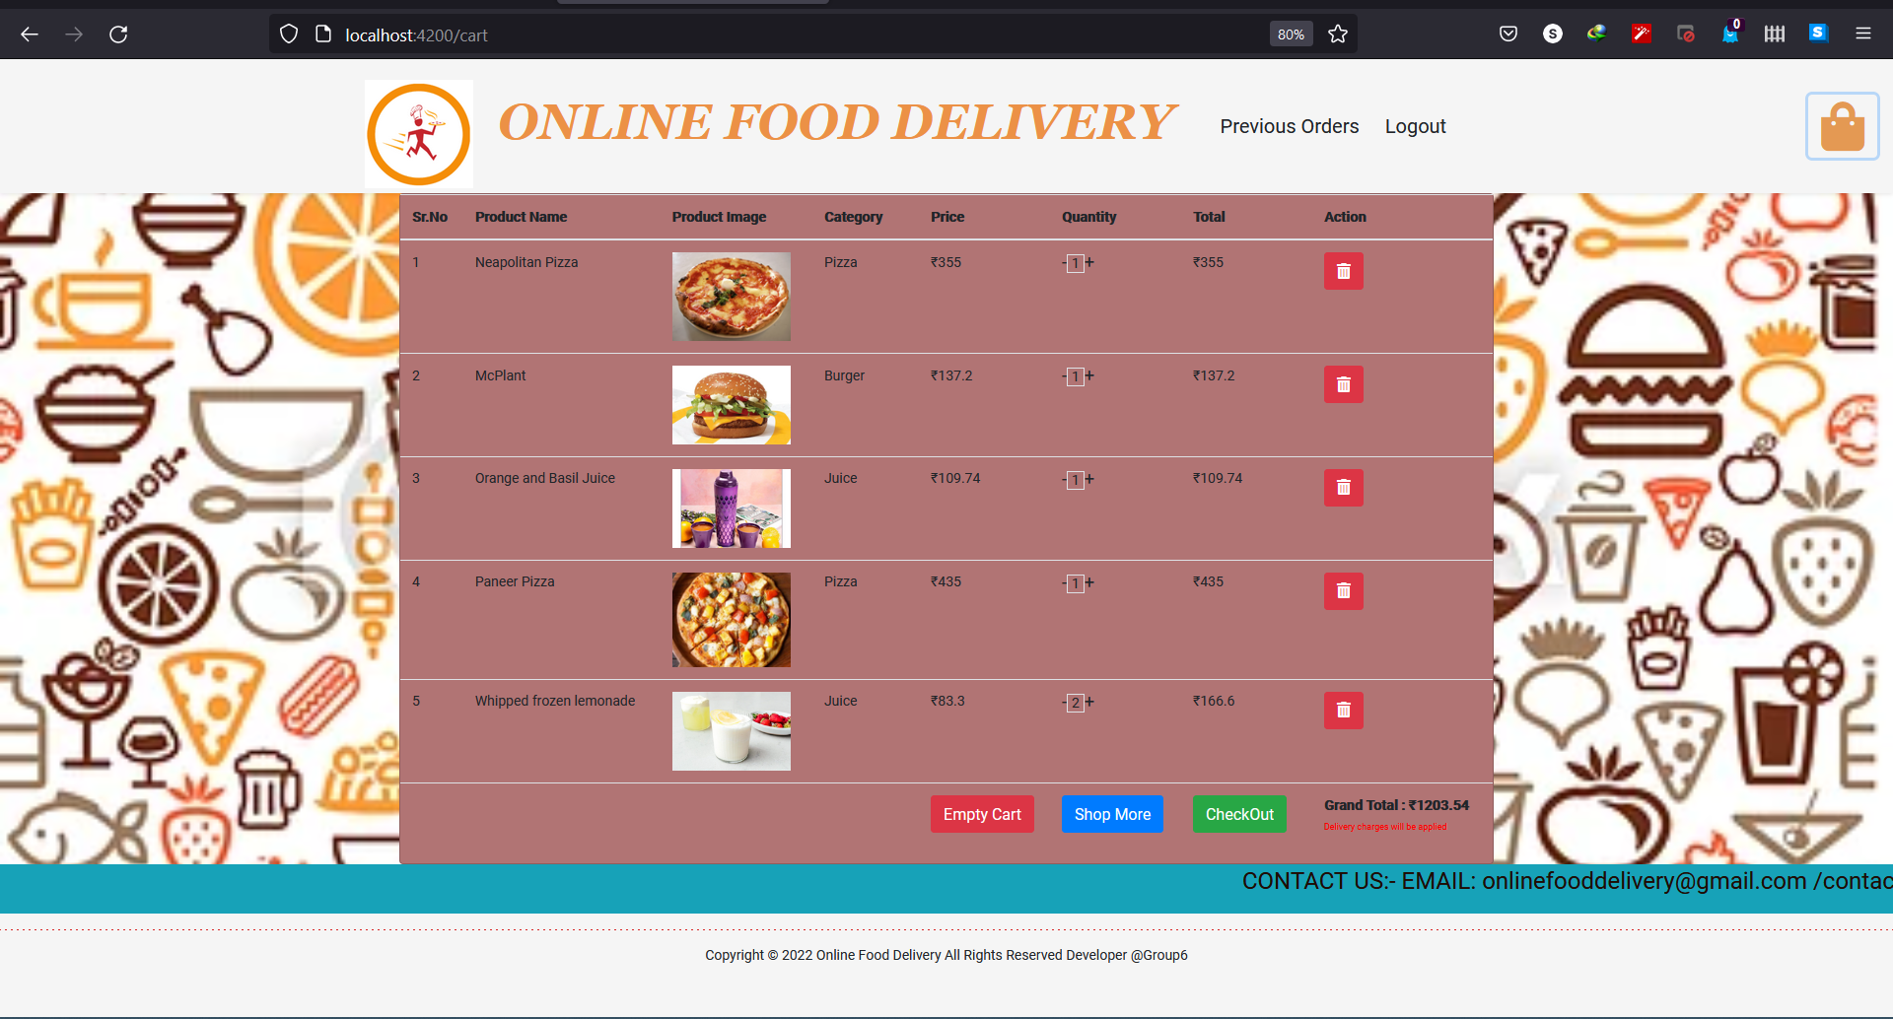

Slide 13
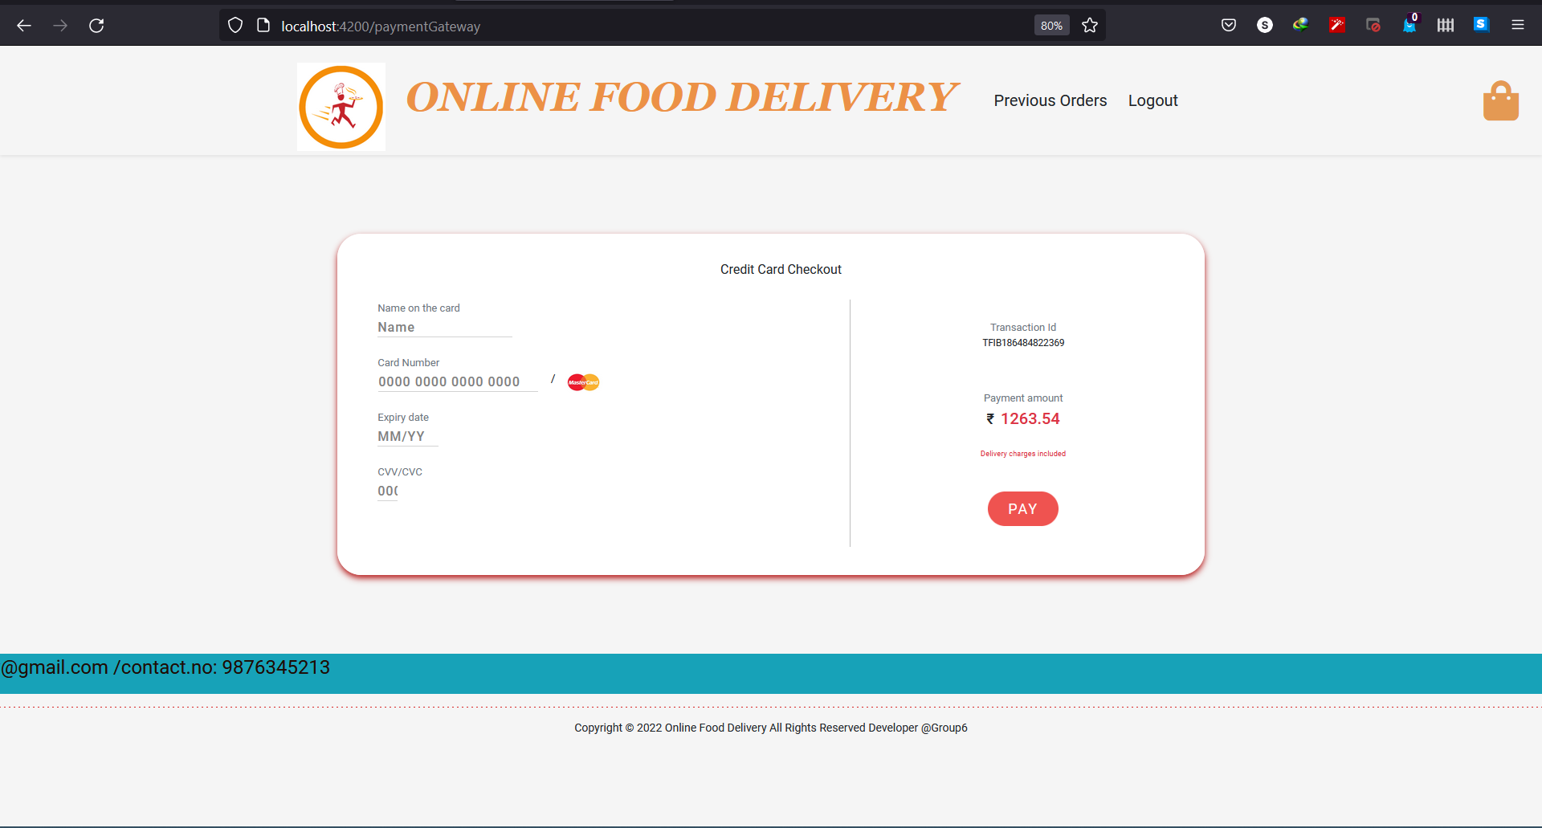

Slide 14
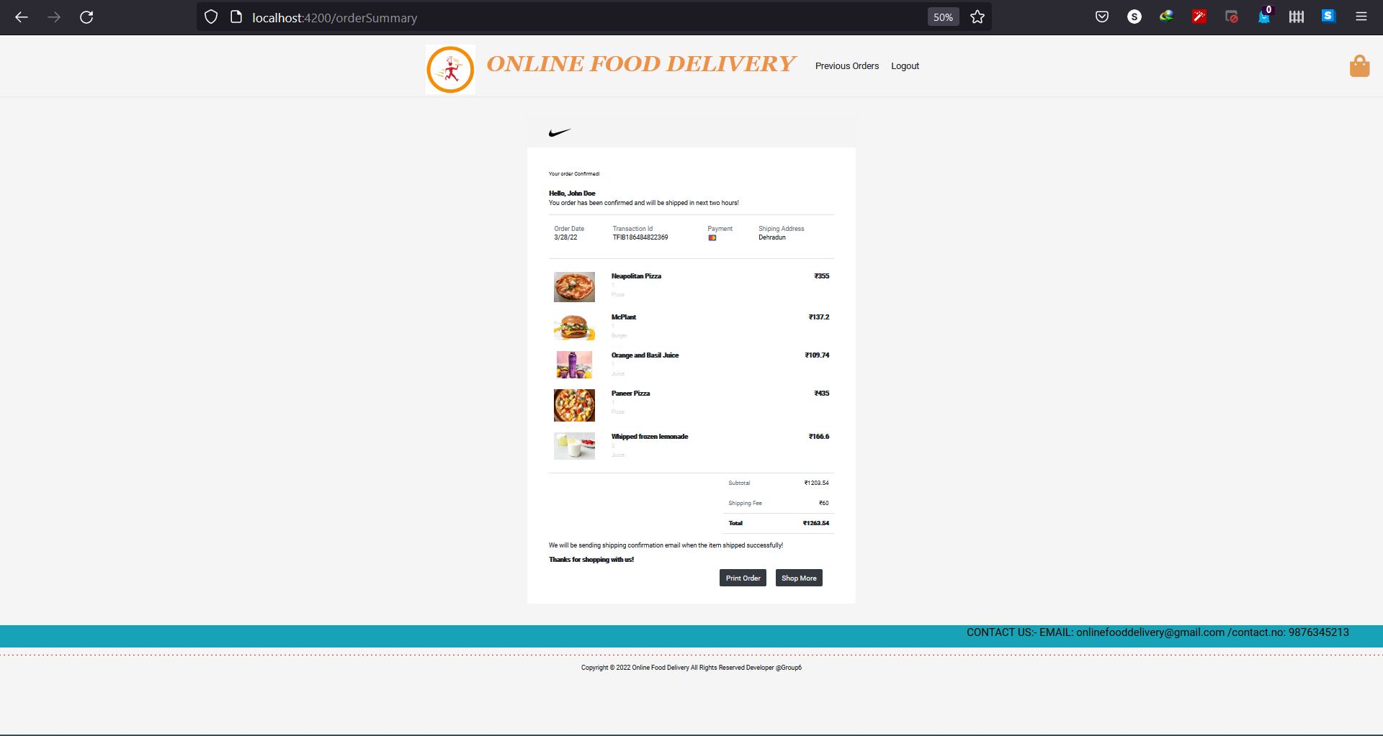

Slide 15
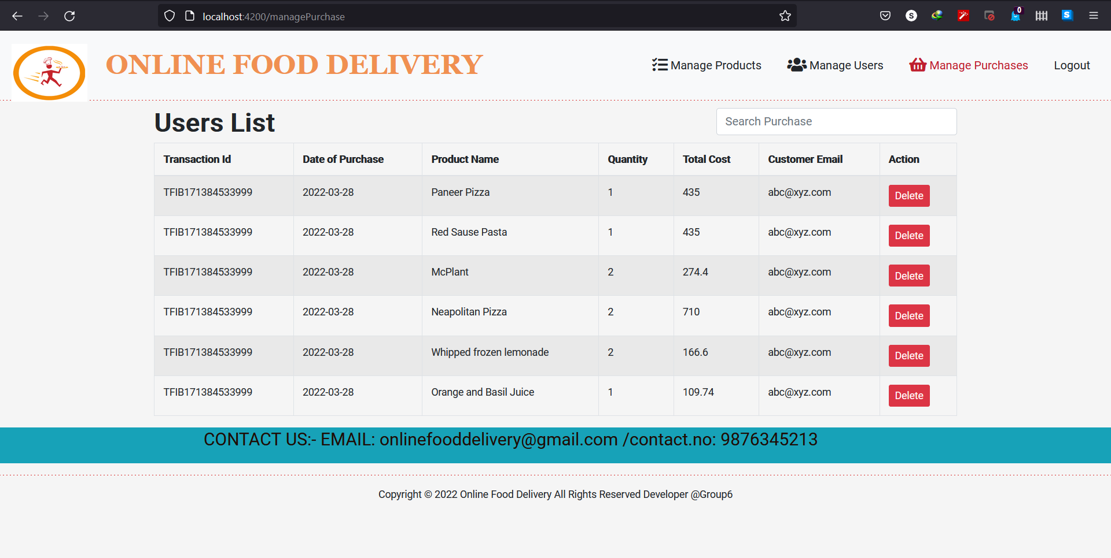
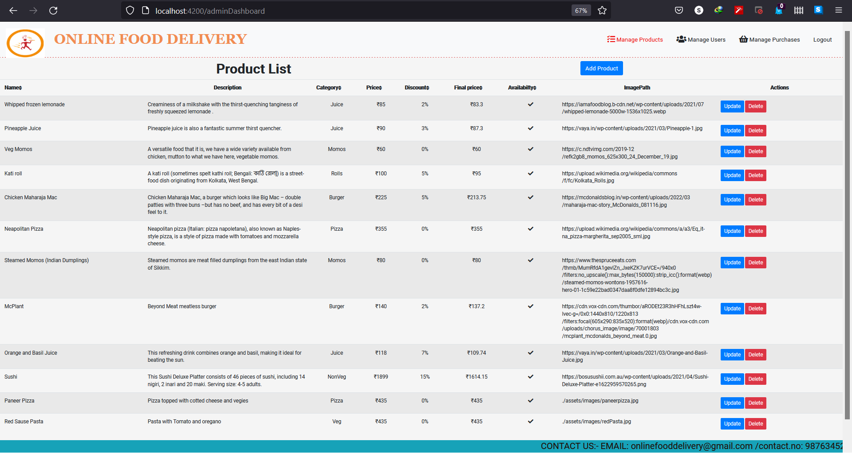

Slide 17
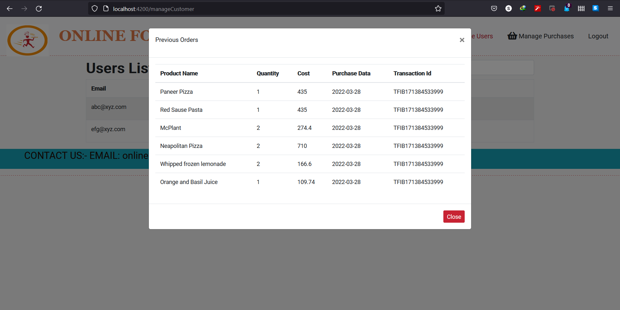

Slide 18
Thank You!

